Slide 1



Online Voting System
Project by -
Jayanth
Shaikshavali
Druvitha
Yuva Sree

Slide 2

Overview:
Online voting
Registering for online voting
Login
Registration
OTP verification
Saving data to database
voting
saving

Slide 3
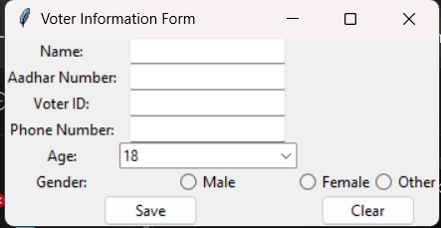
Registration page:
From this page the user will register for online voting
This portal will open before 7 days of elections
Those who are registered for online voting are only allowed to vote online (at voting center this people are not allowed to enter because he was register for online voting, his name was removed from offline voters list)
If they don’t register for online voting they can now go to their respective voting booth for voting

Slide 4
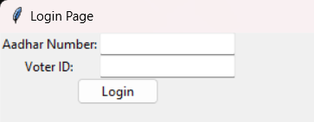
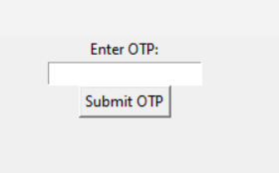
Login page:
On the day of elections:
From this login page the user will login in to the voting page
If login credentials were correct according to database of votes the user will get a conformation OTP
After successful OTP entry the user is now allowed to vote for the party he/she chooses

Slide 5
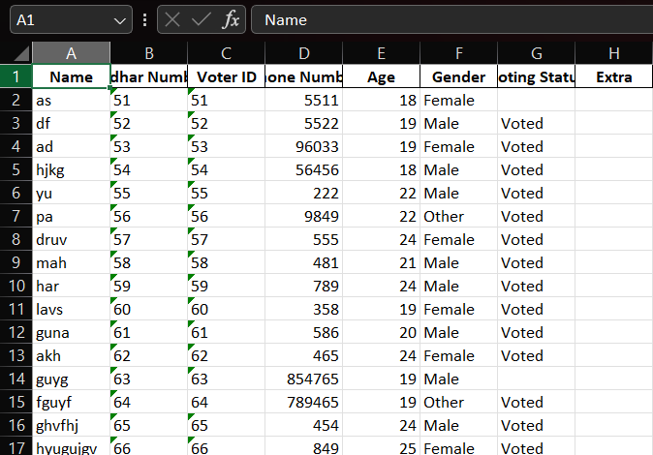
Database of voters:
This is the database of user used for checking whether the user entered correct credentials at login page

Slide 6
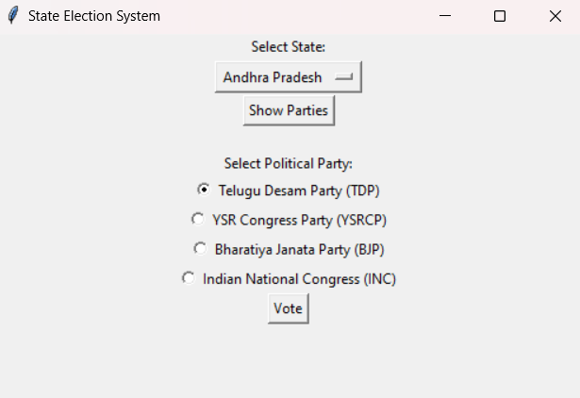
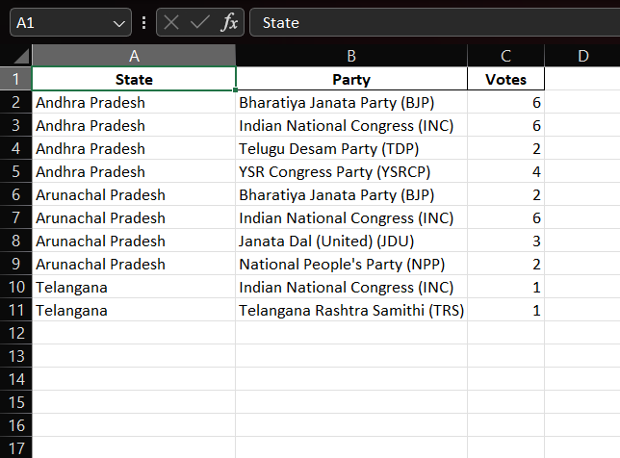
Saving Results
After voting the vote is casted to the respective party and stored in a excel sheet for result declaration

Slide 7
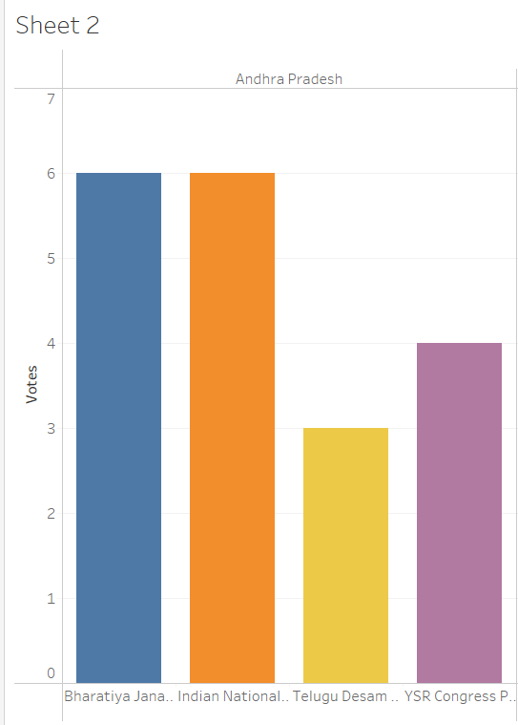
Visualizing Results:
Here we use Tableau software to visualize the results of voting
From this we can declare the winning party

Slide 8


